Slide 1
Decision Trees & Random Forests

Slide 2
01
Overview on Trees

Slide 3
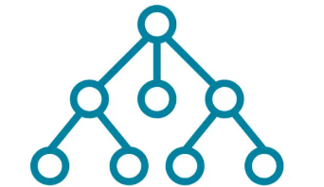
What are Decision Trees?
They are a type of machine learning algorithms that try to capture intelligence in a set of if then else rules, which provide the branches:
Types of trees
Classification Trees
Regression Trees
Decision Tree Anatomy:
Nodes
Branches
Leaf Nodes

Slide 4
02
Regression Tree

Slide 5
Regression Trees
Regression Trees are a type of decision tree where each leaf represent a numeric value.
Each leaf nodes contains n values and we get the output by averaging all this values.
How do we build such tree?
Decide which feature we will split on the current leaf nodes “next slide”
Split the node
Repeat 1 & 2 until building the whole tree or reach a heuristic
Building the whole tree will make us overfit the data.
Heuristics Examples:
Maximum Tree Depth
Minimum Samples split
Maximum number of leaf nodes

Slide 6
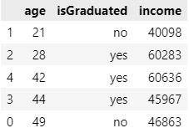

How to decide which split is better?
As it is infeasible to consider all splits we take a greedy approach in constructing our trees
Get all possible splits
For Categorical Values (isGraduated)
There is only one possible spilt (yes or no)
For numerical values (age)
Sort them in ascending order
For each entry make a split for values < age and values >= age
Get the split that have the highest square residual

Slide 7
Example
isGraduated
Age >= 42
Mean: 55628
Mean: 43480
Mean: 51155
Mean: 50190
RSS = 162966622
RSS = 338943081
Note: the yes leaf node is to the left

Slide 8
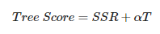
Cost Complexity / Weakest Link pruning
The previous algorithm can help us to have a good fit on the training set, but is likely to overfit the data because it can build a very complex tree that fit every
training example perfectly.
So for some cases a smaller simpler tree can be better.
Heuristics like minimum decrease SSR “Sum of Squared Residuals” can help but they can make us stop before a very good split.
So another approach to solve this problem is pruning “decrease the size of the tree”, where we have a tree score function that penalizes trees with a lot of nodes

Slide 9
Cost Complexity / Weakest Link pruning
Alpha is complexity penalty and T is the number of leaf/terminal nodes.
Algorithm:
Build a full regression tree with the full training data
Prune the tree “remove leaf nodes” to get several subtrees with different alphas.
Use K-fold cross validation to choose the best alpha from step 2
Grow k - 1 regression trees for different values of alpha
Evaluate the error on the left out kth fold
Return the subtree from step 2 that corresponds to this value of alpha

Slide 10
03
Classification Trees

Slide 11
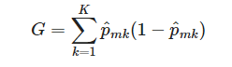
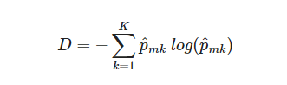
Classification Trees
They are very similar to a regression tree but they have 2 main differences:
They are used for classification
We take the most present class at each leaf node as the output
We can’t use SSR (Sum of Squared Residuals) to split our trees as they are not numerical values
Criterion that are use for splitting our tree:
Gini Index
Entropy
They are just a measure of node purity, which take values between 0 and 1. 1 means impure node while 0 means pure node. With each split we try to reduce the impurity like in regression trees we try to reduce the SSR

Slide 12
04
Pros & Cons of Trees

Slide 13
Pros & Cons of Trees
Very Easy to explain to people
Can be displayed graphically and easily understood even by non experts
Can handle non linear relationships
No need for feature scaling
Automatic feature selection
High variance, a small change in values changes the whole tree
Not so accurate in predictions, especially for data outside what it has trained on
However, by using many decision trees, using methods like bagging, random forests and boosting we can improve the performance significantly.

Slide 14
05
Bagging and Random Forests

Slide 15

Ensemble
Before learning about bagging, we need to understand what is an ensemble?
An ensemble model is a collection of many models to improve the overall performance of a predictive model
The idea behind it is to combine the strengths of different type of models to have :
Better predictive performance
Less variance
Less overfitting
We combine the outputs of the different models to produce the final output. For example: averaging or majority vote

Slide 16
Bagging
Bootstrap aggregation (Bagging) is a general-way for reducing the variance of any learning method but it is frequently used with decision trees.
How it works?
We take B different samples from a single training data set. (Pick random entries with replacement this is called bootstrapping)
For each of the B different bootstrapped sets we create a tree
Why does it work?
An intuition is that we simulate having different datasets with multiple models so the risk of one of the models to overfit will not be that severe as we have other trees that will help us mitigate this issue.
Big values of B’s are used to achieve good performance

Slide 17
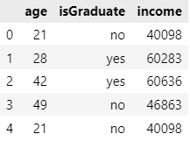
Example of a bagged dataset
Original dataset
Bootstrapped dataset
Note: we need a bigger datasets so bootstrapping can be more effective, but it can still be applied for smaller ones.

Slide 18
Random Forests: An enhanced bagging approach
It follows a similar procedure to bagging but have one addition that decorrelates the trees
Each time we split a tree we only consider a random sample from the predictors/features (most typically we choose sqrt(# of features))
Why are they effective?
Due to the fact that different predictors have different relevance while constructing the tree, this makes most of the trees use the most relevant predictors more often so a lot of the trees look similar. We can say the trees are highly correlated.
Random forests overcome this as not all the predictors are considered at each split so we are somehow decorrelating the trees.
Having decollerated trees leads to a better reduction in variance, as the individual tree errors are more likely to average out in the final prediction

Slide 19
Out of Bag error estimation
Testing Bagging and Random forest is very straightforward. There is no need to use cross validation or a validation set.
On average, ⅔ of the dataset is present in each bootstrap.
So for every observation there are B/3 trees that didn’t use this observation for training.
So we can use this B/3 trees for every observation to produce an output
Then measure the test error for our model as we predicted using the trees that didn’t train with those values.
It is very convenient for huge datasets as cross validation will be very computationally expensive

Slide 20
THANK YOU!

Slide 21
Sources
Statquest
Introduction to Statistical Learning

